Slide 1



NEXT GEN EMPLOYABILITY PROGRAM
Creating a future-ready workforce
Student Name : Maheshwaran.R
Student ID : au820621104038
College Name:
Arasu Engineering College

Slide 2

CAPSTONE PROJECT
Project Title
Voting Application using Django Framework- Maheshwaran.R(4038,AEC)
Abstract | Problem Statement | Project Overview | Proposed Solution | Technology Used | Modelling & Results | Conclusion

Slide 3
ABSTRACT
The Django framework, assures a solid and scalable base. The web-based architecture of the proposed voting application enables users to establish and take part in online votes. The Django framework, a well-liked and robust Python-based web framework that offers a solid foundation for creating scalable and secure online applications, is used in the construction of the application. Along with being scalable and adaptable, the program has a modular architecture that makes modification and extension simple. Because of this, it may be applied to a variety of use cases, ranging from intimate internal voting to extensive public elections. All things considered, the suggested voting application provides a safe, convenient, and adaptable online voting platform. Its emphasis on security and user experience, along , making it an excellent and provides a better security to web applications.

Slide 4
PROBLEM STATEMENT
With more organizations and governments using digital platforms to hold elections and surveys, online voting has grown in popularity in recent years. Online voting does, however, come with a number of drawbacks, mostly with regard to security and integrity. The suggested voting application aims to tackle the issues of security and integrity in online voting, while simultaneously offering an intuitive platform for conducting votes online. Its emphasis on security and user experience, along with its usage of the Django framework, will make it an excellent option for a variety of voting scenarios. The program will emphasis user experience in addition to security, with a clear and simple interface that makes it easy for users to create and participate in votes. The application will support multiple types of votes, including single-choice and multiple-choice votes, and will allow users to set deadlines and restrictions for each vote.

Slide 5
PROJECT OVERVIEW
1.Establishing a Django Project: To provide the framework for the voting application, create a Django project. 2.Creating the Database Schema: Establish the framework for the database that will hold user data, vote tallies, and other pertinent information. 3.Establishing User Authentication: To enable users to sign up, log in, and take part in voting, implement user authentication. 4.Creating the Voting Interface: Create the user interface that allows users to browse options, make selections, and cast ballots. 5.Putting Real-time Results into Practice: Present the voting results in real-time to give users immediate feedback. 6.Creating an Admin Panel: To efficiently manage the candidates, user accounts, and voting process, create an admin panel.

Slide 6
DETAILED SOLUTION
.
Developing a safe and user-friendly online voting platform is the suggested solution for a voting application built with the Django framework. Users of the app will be able to register, cast ballots, and see the results in real time. The Django framework will serve as the cornerstone for developing the application because of its scalability and resilience. In order to manage elections, candidates, and user accounts effectively, the program will feature an admin panel, a secure database, real-time results, and an easy-to-use interface. In conclusion, the Django framework-based voting application that has been suggested offers a safe, adaptable, and user-friendly online voting platform. Its emphasis on security and user experience, along with its use of the Django framework, assures a solid and scalable base, making it an excellent ideal choice for a wide range of voting scenarios.

Slide 7
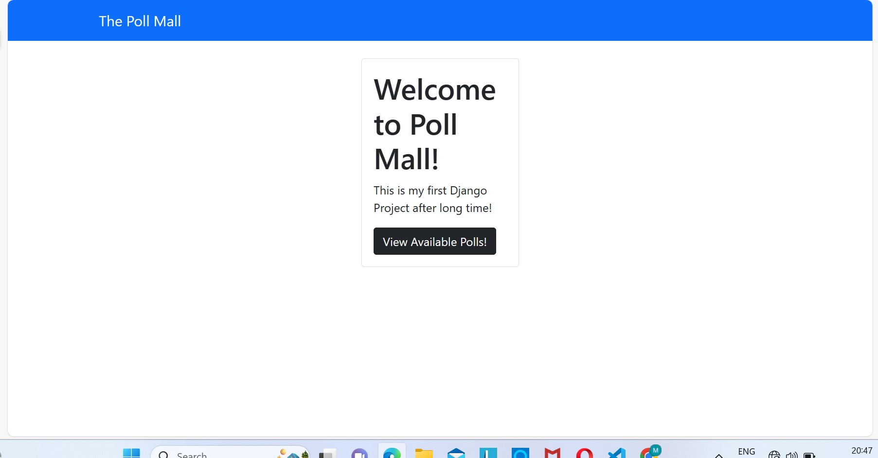
HOME PAGE

Slide 8
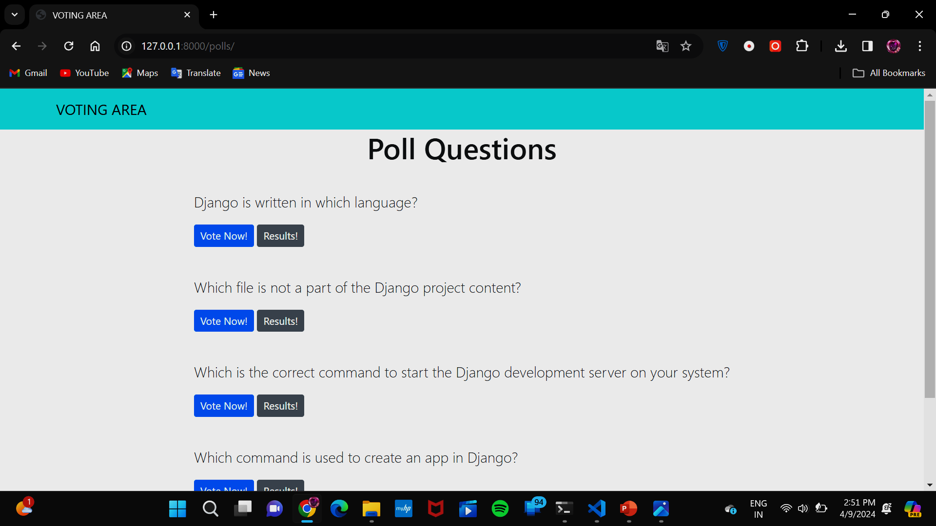
POLL PAGE

Slide 9
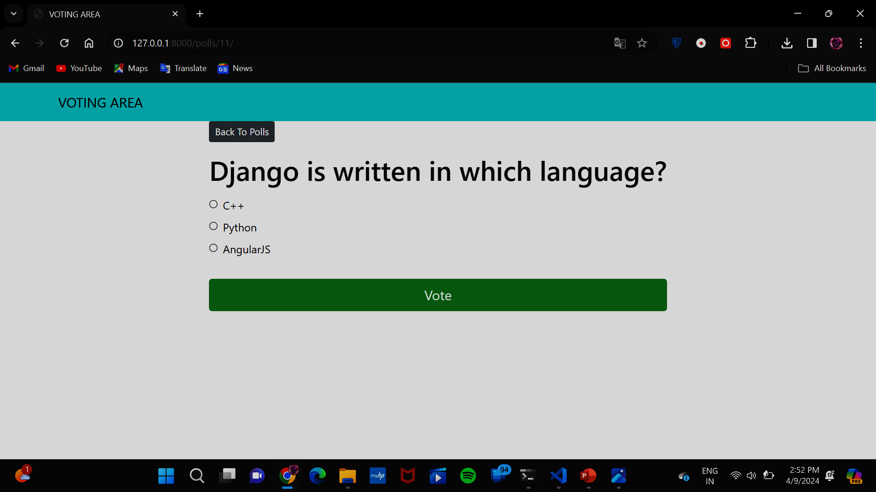
VOTING PAGE

Slide 10
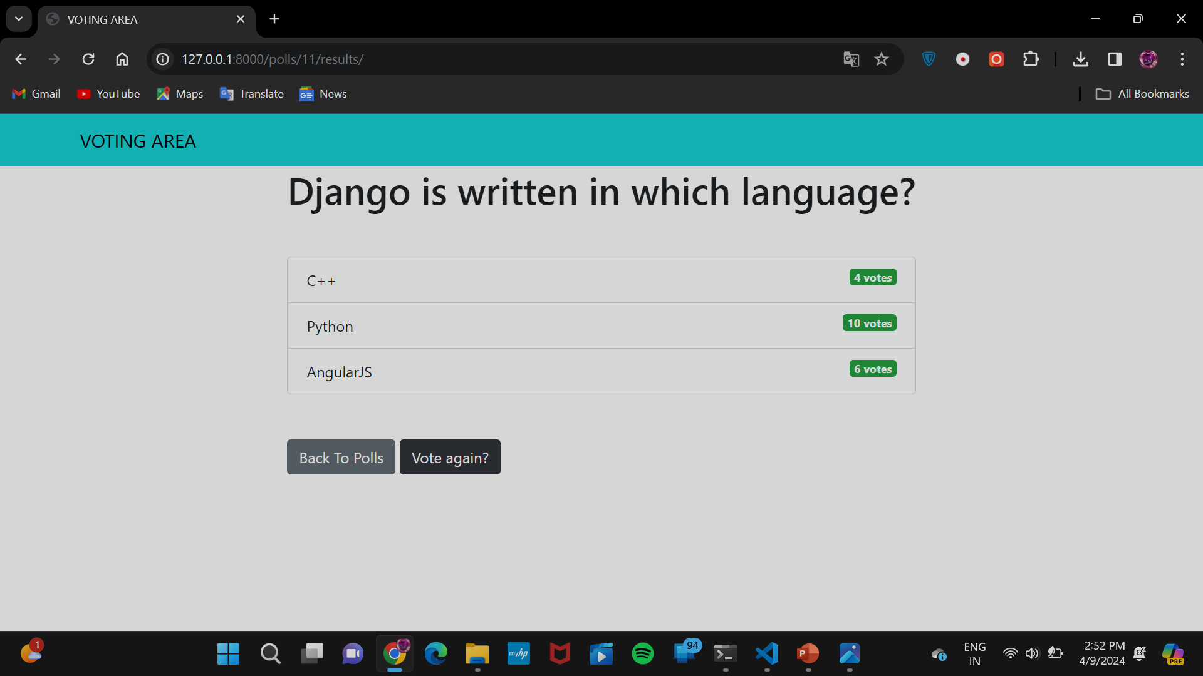
VOTING DETAILS PAGE

Slide 11
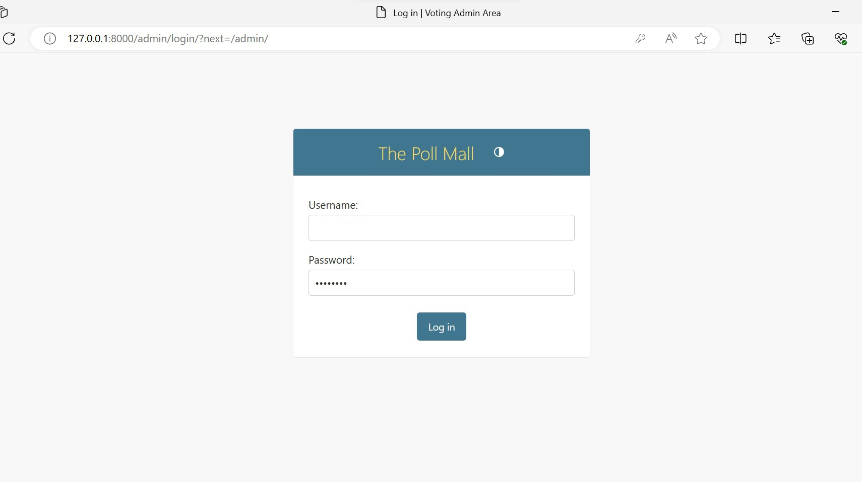
ADMIN LOGIN PAGE
Mahendran.B
Maheshwaran.R

Slide 12
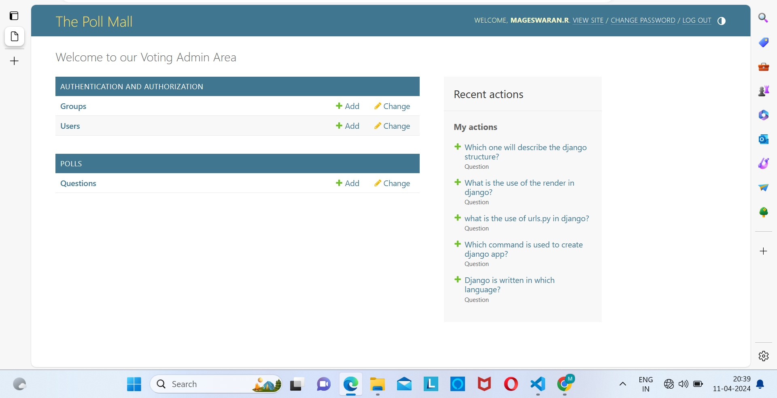
ADMIN HOME PAGE

Slide 13
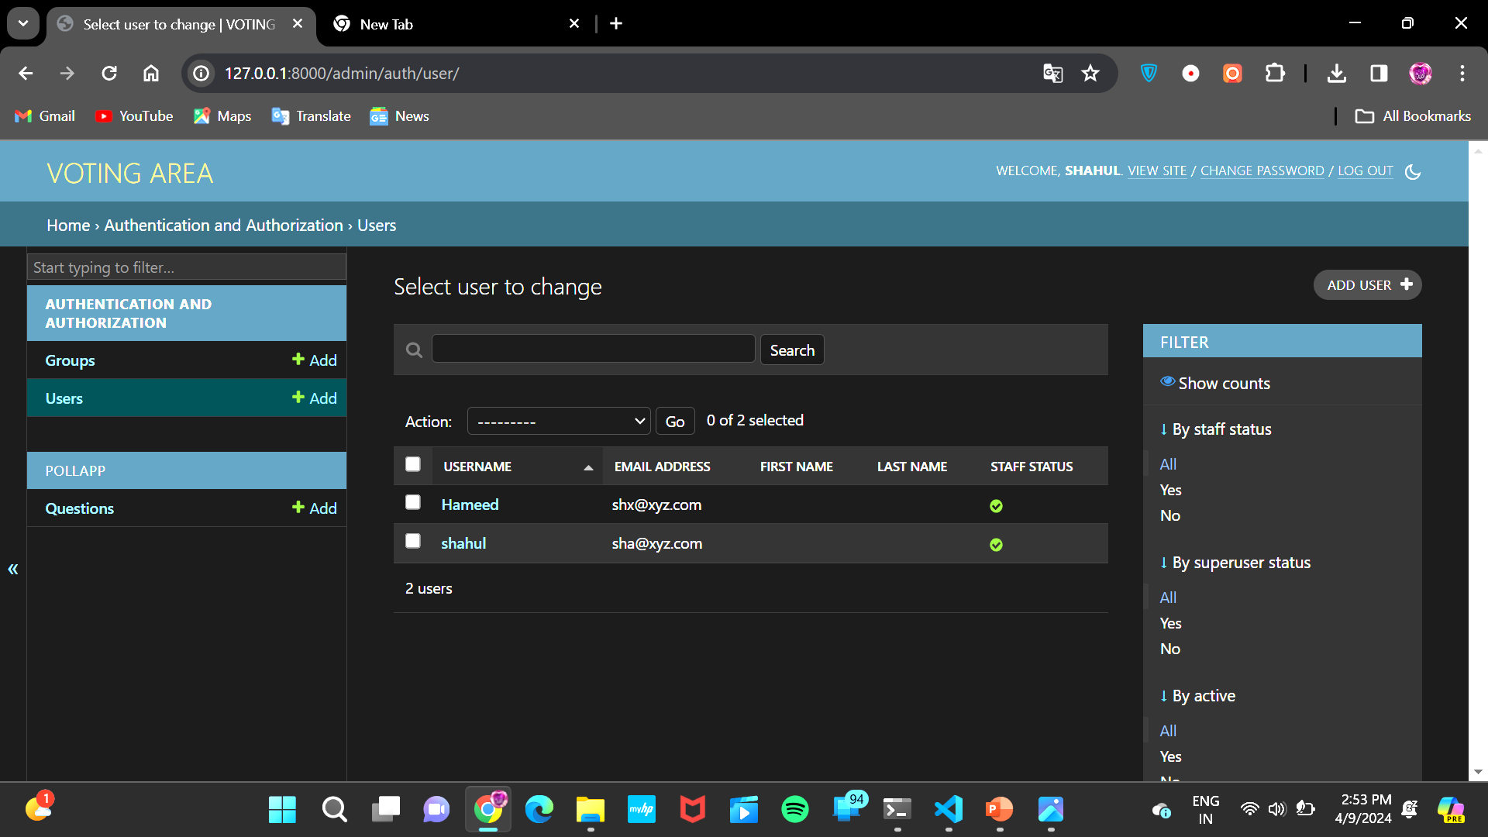
AUTHENTICATION AND AUTHORIZATION PAGE

Slide 14
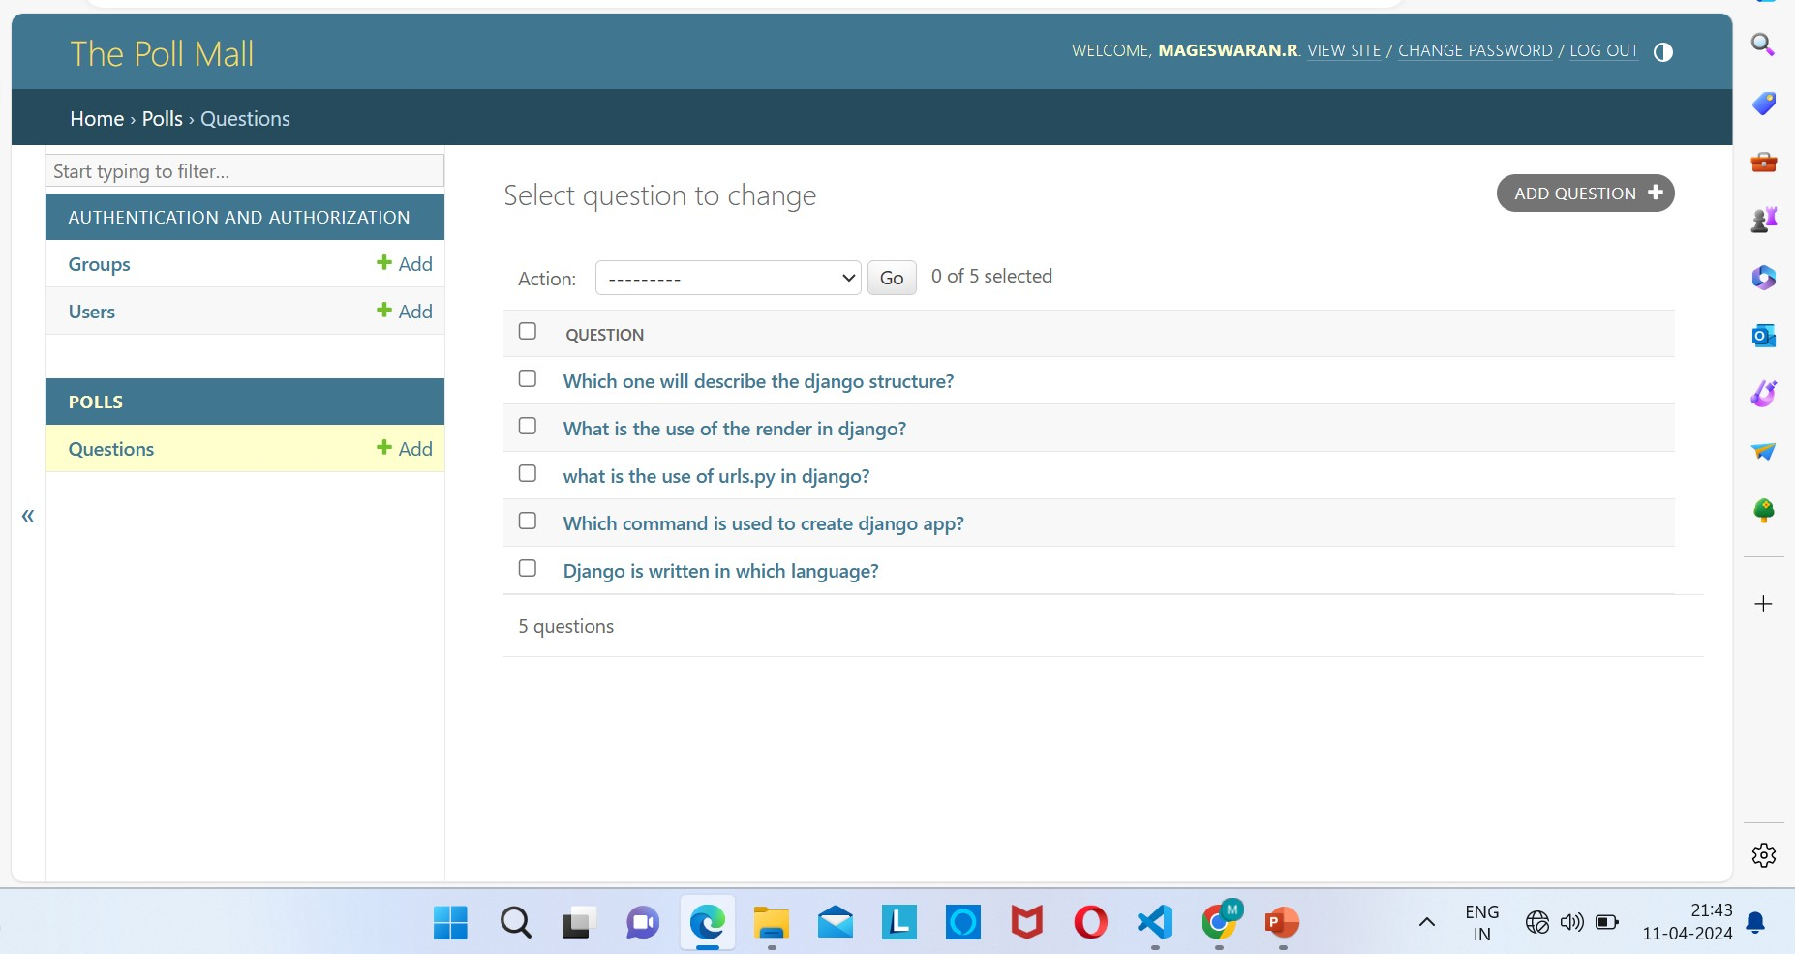
QUESTIONS ADDING SECTION PAGE

Slide 15
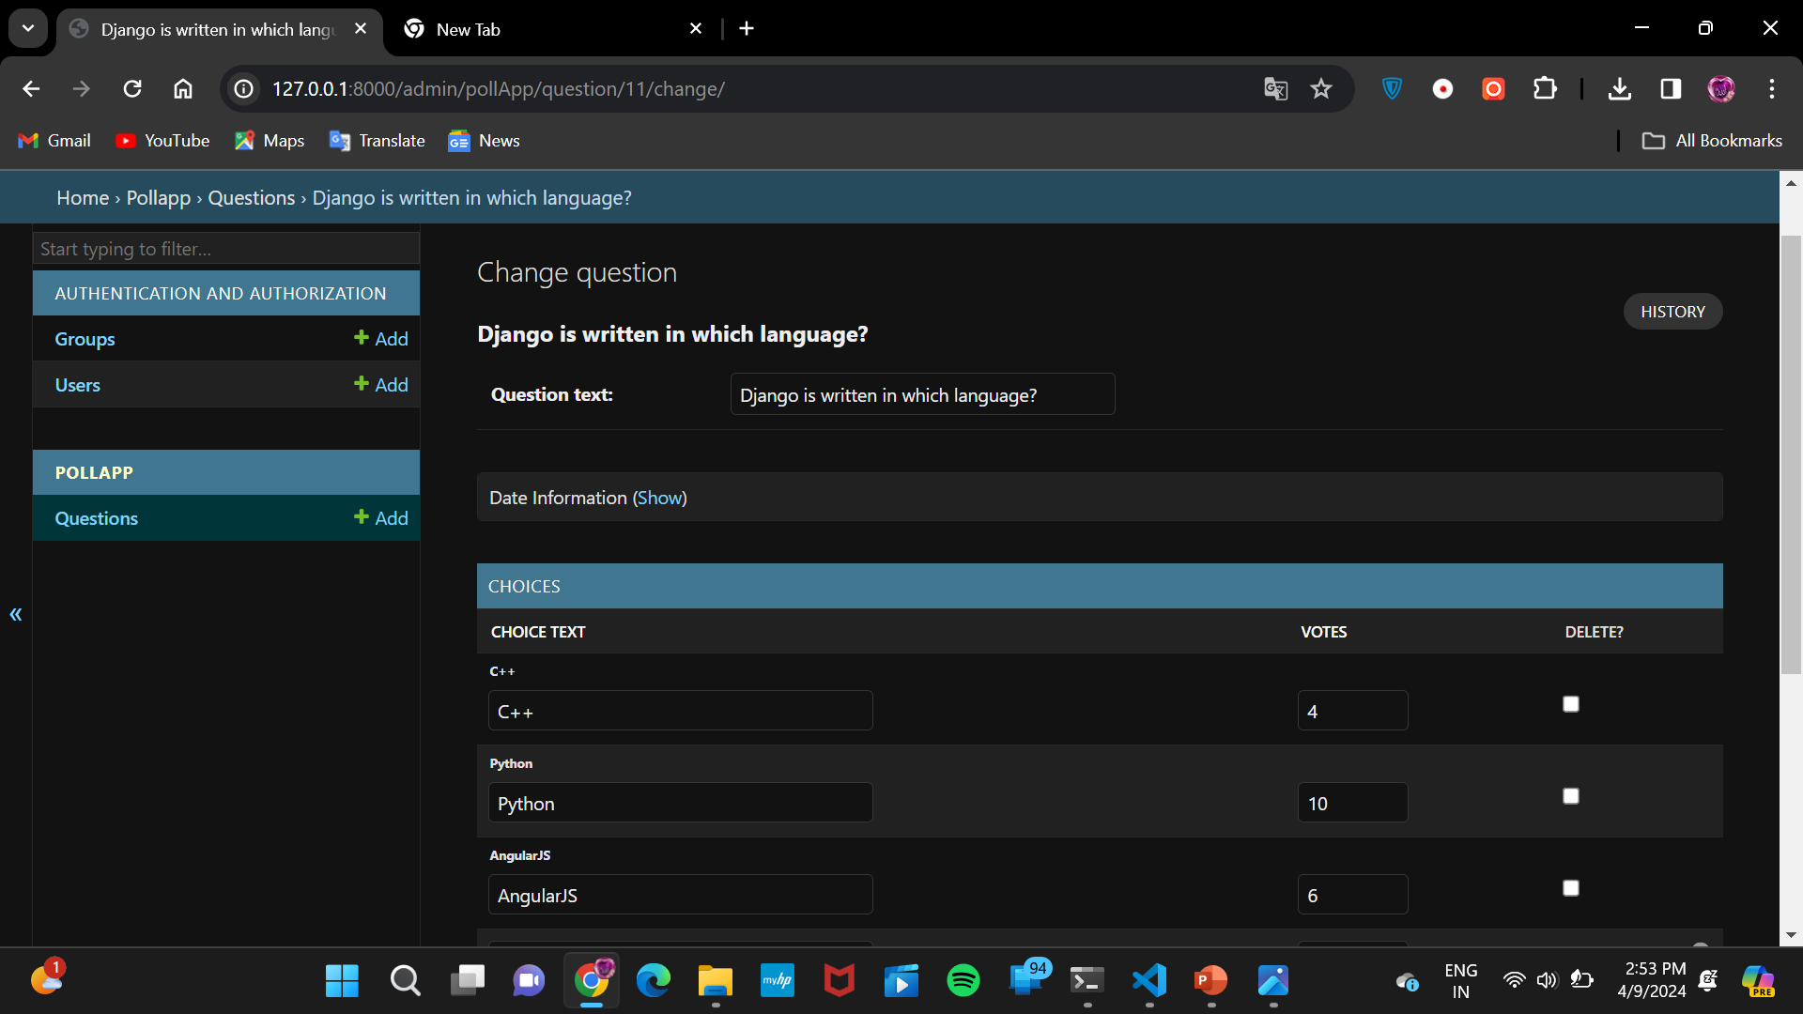
VOTING DETAILS PAGE

Slide 16

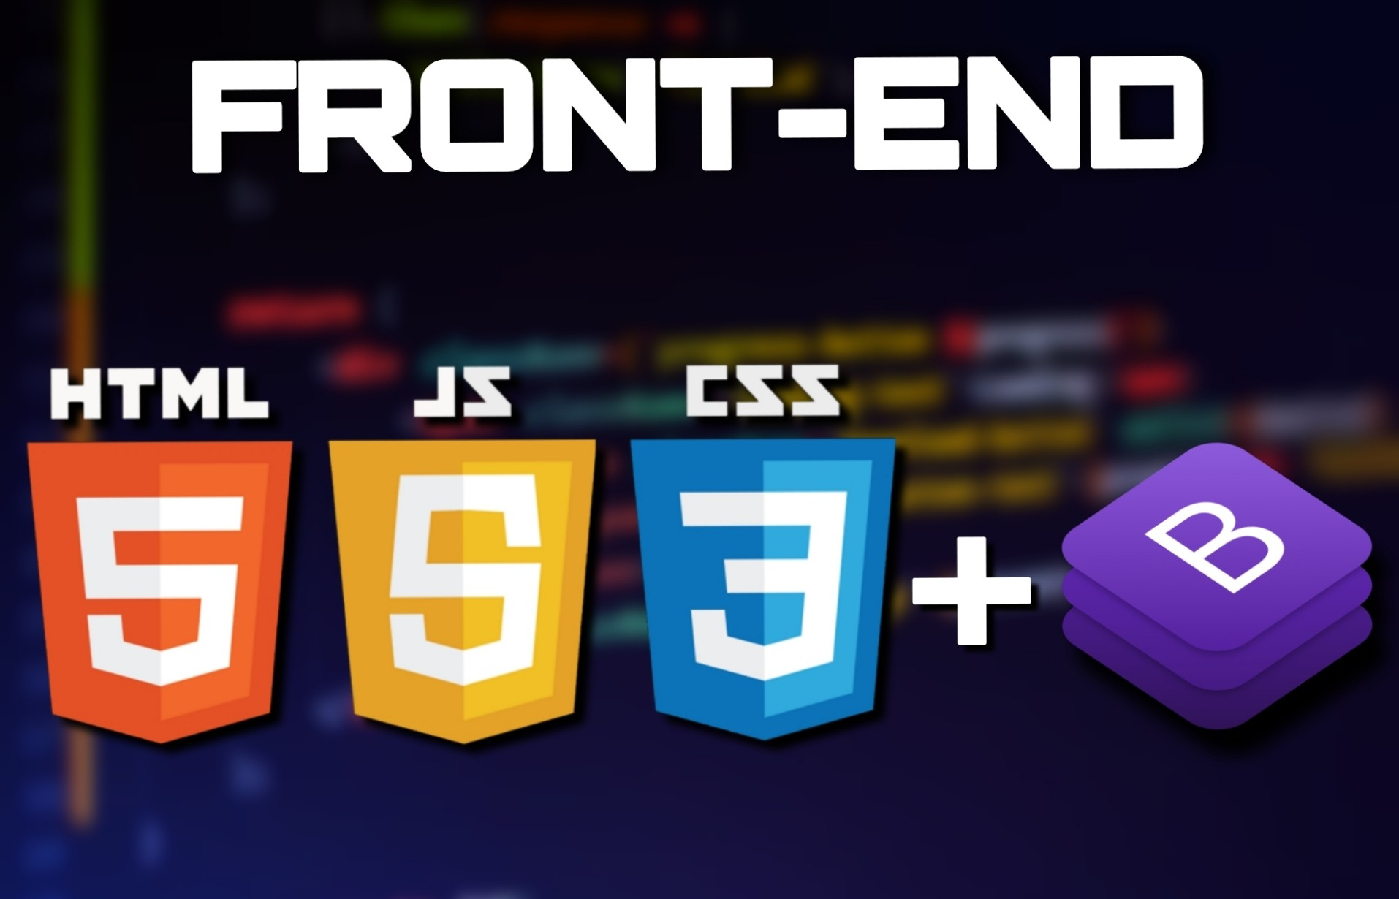
Technology Used
FRONT-END
BACK-END

Slide 17
CONCLUSION
A good understanding of HTML, CSS, Bootstrap, Django, and Python programming to design a voting application using Django. The development process entails starting a fresh Django project, building a Django application, specifying models, views, templates, and locations. Features like a user-friendly interface, a secure database design, and real-time results can further improve the program. An admin panel for controlling elections, candidates, and user accounts may also be included. All things considered, a voting application built using the Django framework is a strong and adaptable way to build online voting systems that meet different needs and use cases.

